Slide 1


Security Information and event management(SIEM)
This project focuses on developing and evaluating machine learning models for classifying the legitimacy of different files. It compares Random Forest, KNN, and XGBoost algorithms, using features like application name, MD5 hash, and code size. The goal is to enhance cybersecurity defenses against evolving threats by leveraging static analysis and machine learning methodologies.

Slide 2
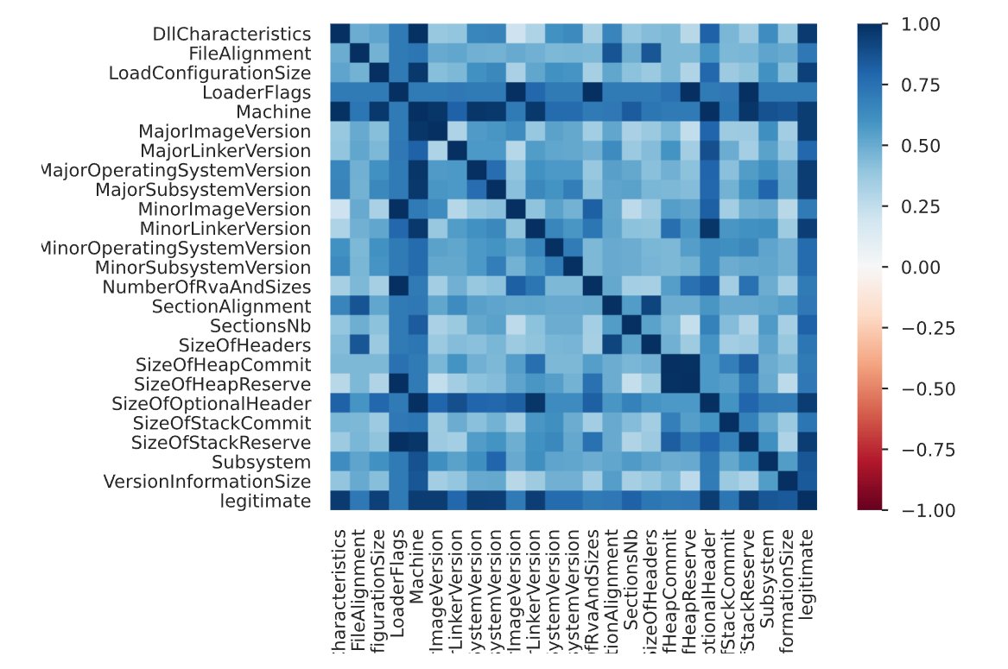
Data Collection and Preprocessing
Introduction to Data Collection and Preprocessing
Data preprocessing is a crucial first step in any machine learning project as it directly impacts the quality of the model's output.
It involves cleaning, transforming, and preparing raw data to make it suitable for machine learning algorithms.
The dataset used in this project was sourced from virus total,
containing various features of software applications.
Initial preprocessing involved removing duplicate entries and irrelevant attributes to ensure data quality and focus on pertinent information.

Slide 3
Preprocessing Methods
Data Preprocessing Methods
One-Hot Encoding:
Scaling
This technique was applied to categorical variables, specifically file names, converting them into a binary matrix representation.
StandardScaler and MinMaxScaler were employed to normalize the distribution of numerical features.
Explanation:
Explanation: Each unique category becomes a binary column, indicating the presence or absence of that category for each data point.
StandardScaler transforms features to have a mean of zero and a standard deviation of one.
MinMaxScaler scales features to a specific range (e.g., 0 to 1).
Benefit: Allows machine learning algorithms to effectively utilize categorical data, which they cannot directly process in its original form.
Benefit: Ensures that all features contribute equally to the model training process, preventing features with larger scales from dominating

Slide 4
Model Training:
Random Forest
Random Forest is an ensemble learning method known for its high accuracy and robustness and ability to work in most cases.
It operates by constructing a multitude of decision trees during training and combining their predictions.
Each tree in the forest is trained on a random subset of the data and a random subset of the features.
This randomness helps to reduce overfitting and improve the model's ability to generalize to unseen data.
Provides improved predictive accuracy compared to individual decision trees and offers inherent feature importance ranking.

Slide 5



Random Forest Implementation
The Random Forest Classifier was trained on the preprocessed dataset to classify different files
as either legitimate or malicious.
Key parameters of the Random Forest model (e.g., the number of trees, maximum depth of trees) were set and potentially tuned to optimize performance.

Slide 6



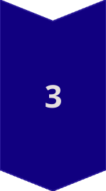
K-Nearest Neighbors (KNN)
K-Nearest Neighbors (KNN) is a simple, instance-based, non-parametric algorithm.
It classifies data points based on the majority class among their 'k' nearest neighbors in the feature space.
'k' is a crucial parameter that determines how many neighbors influence the classification.
KNN is easy to understand and implement but can be computationally expensive with large datasets.

Slide 7

KNN Implementation
The KNN Classifier was trained on the preprocessed data to predict the legitimacy of software applications..
Experiments were conducted with different values of 'k' to find the one that yields the best performance.
Techniques like cross-validation were used to evaluate the model's performance for different 'k' values and select the most suitable one.
Considerations:
Small 'k' values can make the model sensitive to noise.
Large 'k' values can smooth out decision boundaries and may miss local patterns.

Slide 8




Introduction to XGBoost
Feature Selection: Identify significant features for classification.
Gradient boosting is an ensemble technique that sequentially adds decision trees, where each new tree corrects the errors of the previous ones
XGBoost is designed for speed and performance, making it suitable for large and complex datasets
Benefit: Known for its effectiveness in handling structured or tabular datasets and often achieves state-of-the-art results.

Slide 9



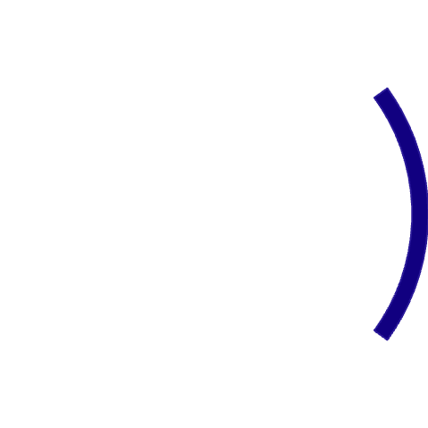






XGBoost Implementation
XGBoost has several parameters that can be tuned to optimize its performance, such as:
The XGBoost Classifier was trained on the preprocessed dataset to classify software.
Learning rate: Controls the contribution of each tree.
Maximum depth of trees: Limits the complexity of individual trees
Techniques like grid search or randomized search were likely used to find the best combination of parameters.
Number of estimators: The total number of trees in the ensemble.

Slide 10
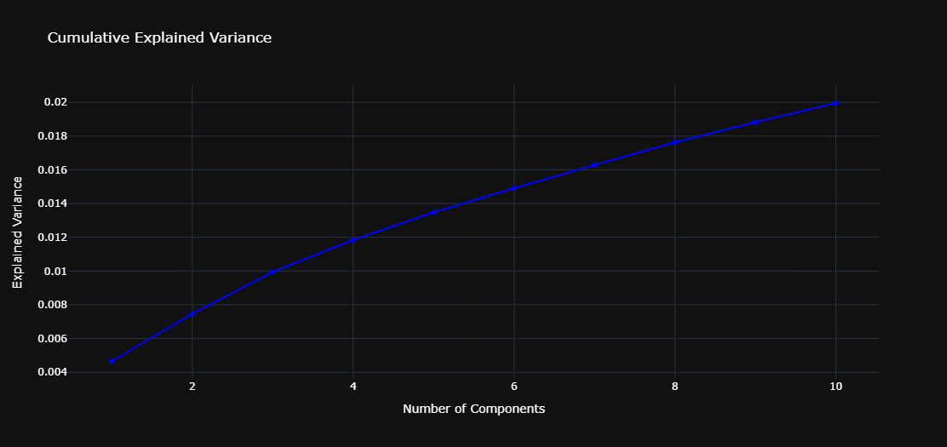
Model Optimization: PCA
Principal Component Analysis (PCA) is a dimensionality reduction technique used to simplify complex datasets.
It transforms the original features into a new set of uncorrelated variables called principal components.
Principal components are ordered by the amount of variance they explain in the data.
Reduces computational complexity by decreasing the number of features while retaining the most important information

Slide 11
PCA Implementation
Title: PCA Implementation
Bullet: PCA was applied to the dataset to reduce the number of features, making the models more efficient and less prone to overfitting.
Bullet: The number of principal components to retain was determined by analyzing the explained variance ratio.
Explanation: The explained variance ratio indicates how much of the total variance in the data is explained by each principal component.
2D and 3D scatter plots were used to visualize the data in the reduced-dimensional space after applying PCA.
This helps in understanding the data structure, identifying clusters, and observing the separation between legitimate and malicious software

Slide 12
Model Evaluation and Visualization
Model Evaluation Metrics
Accuracy
Precision & Recall
Cross-Validation: final value =15
The proportion of correctly classified instances (both legitimate and malicious) out of the total number of instances.
1 )The proportion of correctly predicted malicious software out of all instances predicted as malicious.
A technique used to assess how well the model generalizes to unseen data.
The data was divided into multiple subsets, and the model is trained and evaluated multiple times, each time using a different subset as the test set.
2)The proportion of correctly predicted malicious software out of all actual malicious software.

Slide 13
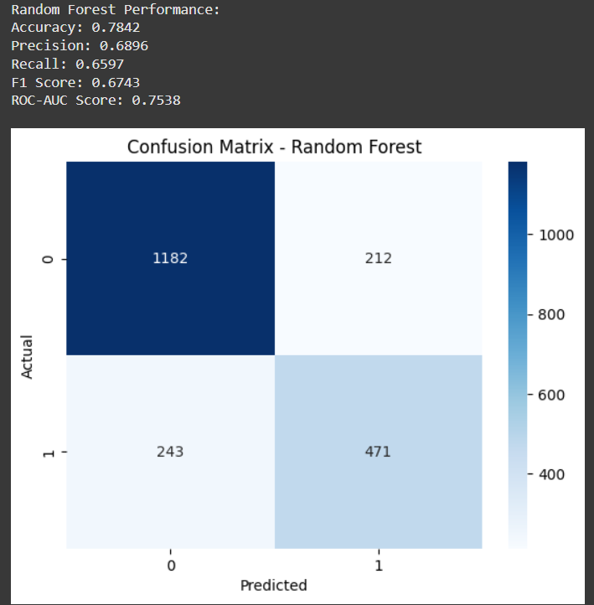
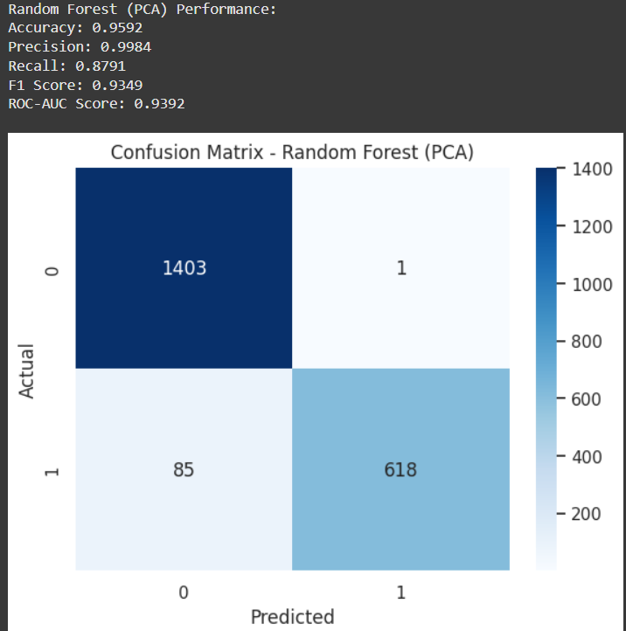
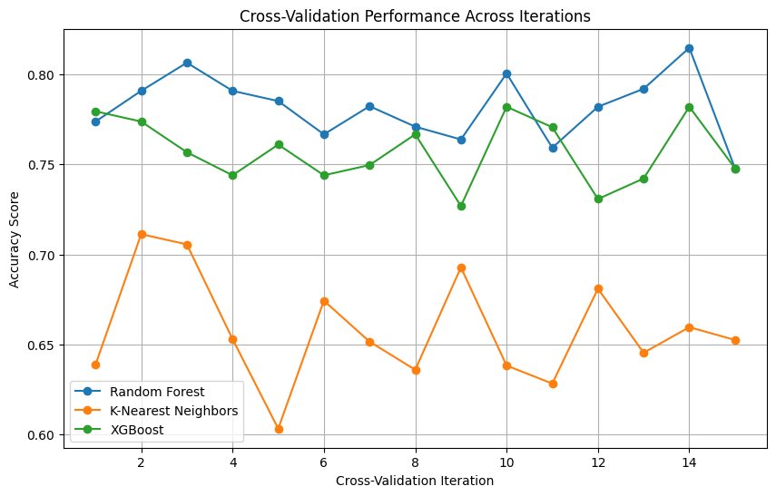
CONFUSION MATRIX
Precision increased dramatically from ~68.97% → 99.84%→ The model almost never predicts "threat" unless it’s sure — very few false alarms.
Recall also improved from ~65.97% → 87.91%
After PCA
15 fold cross validation of all models

Slide 14
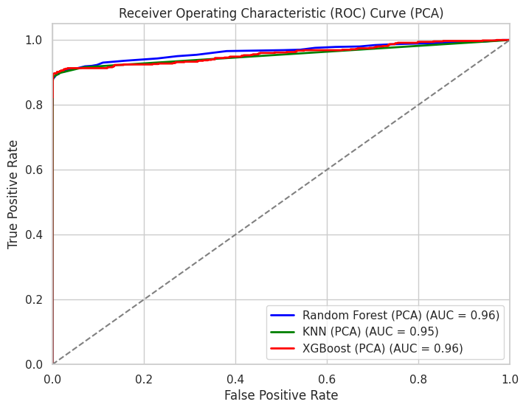
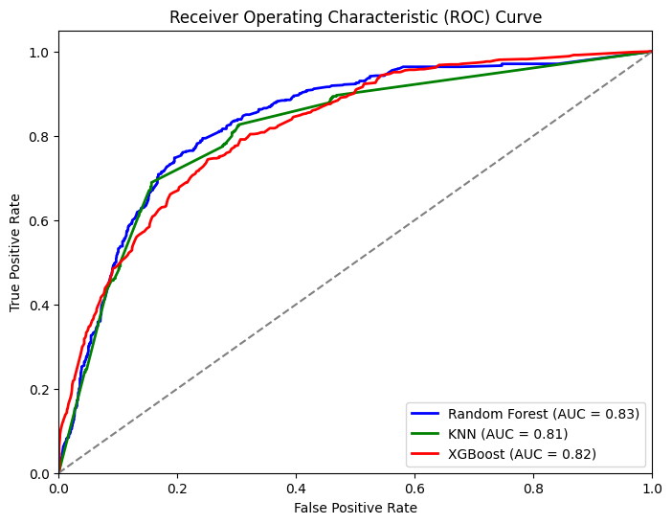
ROC Curve and AUC Score
After PCA
The ROC curve shows how well a classification model distinguishes between two classes by plotting the True Positive Rate (TPR) against the False Positive Rate (FPR) at different threshold values. The diagonal line (45-degree line) represents a random guess (AUC = 0.5), while a perfect model reaches (1,1) with an AUC of 1."
AUC (Area Under the Curve) is a performance metric used to evaluate classification models, specifically in ROC (Receiver Operating Characteristic) curves.

Slide 15
CONCLUSION
Principal Component Analysis (PCA) plays a crucial role in network security and the antivirus industry by enhancing threat detection and improving efficiency. By reducing high-dimensional data, PCA helps identify patterns in network traffic, detect anomalies, and enhance intrusion detection systems. It aids in malware classification by extracting key features from large datasets, allowing security systems to operate faster and more accurately. Overall, PCA strengthens cybersecurity by optimizing threat detection while minimizing computational costs.

